Slide 1

F21BC- Additional Material EAs
Dr. Mohammad Hamdan
School of Mathematical and Computer Sciences
Heriot-Watt University Dubai

Slide 2
Motivation
We use computer science techniques to solve various problems related to search, sort, optimization … etc
We already know various computer science techniques that can be used to solve few of these problems.

Slide 3
However, our existing techniques might:
Take a very long time to solve a problem, or
We are not very happy with the best solutions that the existing techniques did find for us.
THEREFORE
We try to find alternative techniques for our existing problems.
One approach is to observe and study biological systems in order to develop computational techniques that can be used to solve existing problems in the hope we can get a better solution (or very close to the optimal solution) in reasonable computational time.

Slide 4
Alternative Techniques
Adding parallelism to the design and implementation of the current algorithm.
Look at different algorithmic design techniques such as: divide and conquer, greedy, back tracking, dynamic programming and branch and bound/cut .
Or try some of the BIC algorithms

Slide 5
Overview of BIC
Biologically inspired computing is part of what is called natural computing.
The main idea is to study nature and natural systems in order to develop state of the art computing algorithms that can be used in solving complex problems.
It is related to Artificial Intelligence and relies on biology, computer science and mathematics.

Slide 6

Major Areas of Investigation and Study
In Biology | In Computing
Evolution | Evolutionary Algorithms
Ants, Bees, flock of birds, schools of fish | Swarm Intelligence
Plant Structures | L-Systems
Immune System | Artificial Immune System
The brain | Neural Networks
life | Artificial life, cellular Automata

Slide 7
However, our existing techniques might:
Take a very long time to solve a problem, or
We are not very happy with the best solutions that the existing techniques did find for us.
THEREFORE
We try to find alternative techniques for our existing problems.
One approach is to observe and study biological systems in order to develop computational techniques that can be used to solve existing problems in the hope we can get a better solution (or very close to the optimal solution) in reasonable computational time.

Slide 8
An Example
Suppose you want to visit a number of cities in a country exactly once and you want to minimize the total travelled distance.
Also you want to return to the starting city.
(This is well known combinatorial problem known as the Travelling Sales-man Problem – TSP).
A formal description of the problem will be given later.
Let us have a real example.

Slide 9
4-cities from Jordan
Assume we have the following distance matrix (in km):
 | Irbid | Amman | Zarqa | Aqaba
Irbid | 0 | 89 | 59 | 412
Amman | 89 | 0 | 23 | 328
Zarqa | 59 | 23 | 0 | 349
Aqaba | 412 | 328 | 349 | 0

Slide 10
A simple algorithm to solve TSP
Step 1: Generate all possible different combinations
Step 2: Evaluate the total tour length for every single tour that was generated
Step 3: Find the tour with the minimum tour length
This method is called exhaustive search as all possibilities were generated. Will give you the optimal solution.

Slide 11
The algorithm in Action
Generate all possible solutions: (for this example there are 6 different possibilities for every single city we might take as the starting point – In total there are 24 different tours. Below are some possible tours)
Possible Tours | Tour Length
Ir-Am-Aq-Za-Ir | 825
Ir-Am-Za-Aq-Ir | 873
Ir-Za-Am-Aq-Ir | 822
Am-Ir-Za-Aq-Am | 825
Am-Ir-Aq-Za-Am | 873
Za-Am-Ir-Aq-Za | 873
Za-Am-Aq-Ir-Za | 822

Slide 12
TSP-continued
Search the 24 different possibilities and take the tour with the minimum length.
Note that 4! = 24
Think of the time it would take a computer to run the previous algorithm and generate solutions.
Assume we are using a machine that needs second to generate a single tour and evaluate the tour length =>
Our previous program (with only 4 cities) needs only seconds.
Think of more cities

Slide 13
Number of cities | Time
4 | 0.000024 seconds
5 | 0.00012 seconds
6 | 0.00072 seconds
7 | 0.00504 seconds
10 | 3.63 seconds
11 | 39.9 seconds
13 | 1.73 hours
14 | 1 day + 7 min
17 | 11.27 years
20 | 77094 years

Slide 14
What will you do for real applications having large number of cities.
It is clear that this approach is not practical for more than 14 cities.
Assume we use a faster machine, it will be only a couple of extra cities for the program to take very long time to finish.
Why this situation?

Slide 15
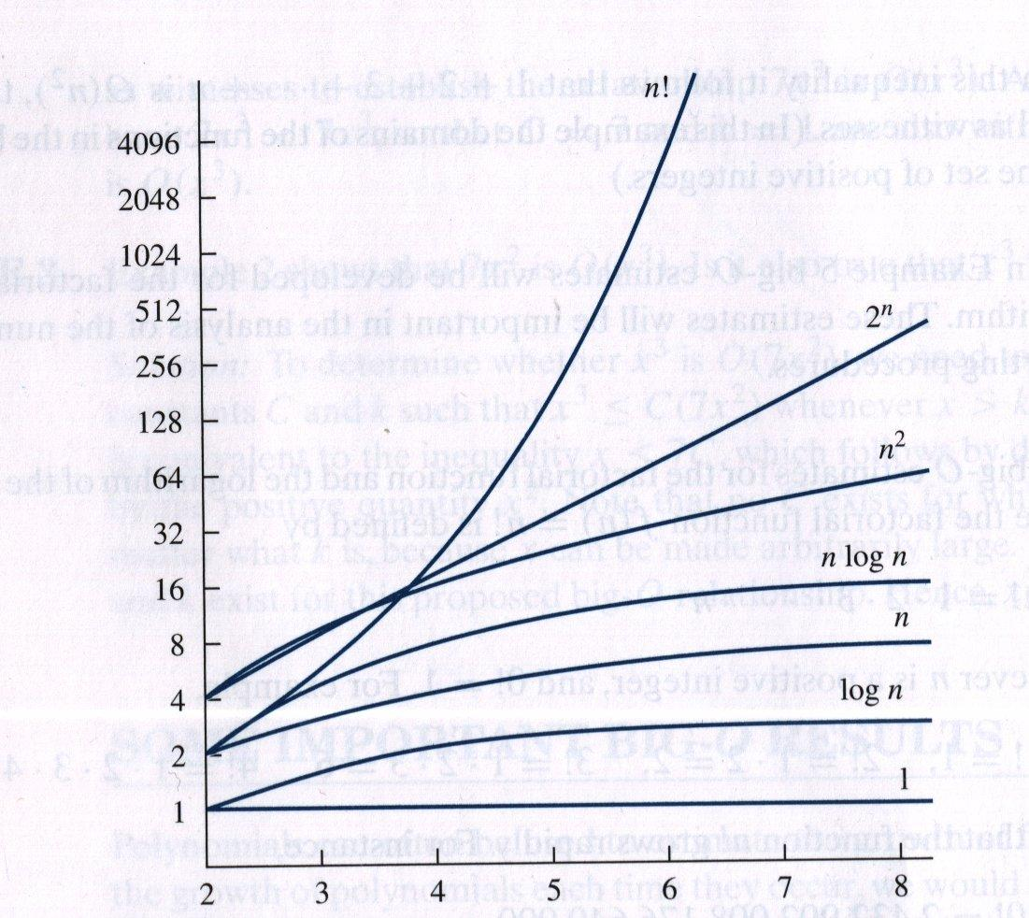
Remember Algorithmic Complexity and Growth of Functions This algorithm has O(n!)

Slide 16
Alternative Methods
Other approaches do solve this problem in less time.
For example, a parallel branch and cut algorithm can solve the TSP problem in
However, still not efficient for large number of cities.

Slide 17
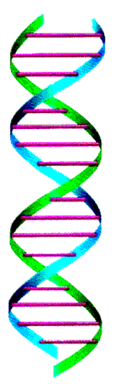
Evolutionary Algorithms
Well known as Genetic Algorithms
Invented by John Holland and developed later by him, his students and colleagues in 1975 at University of Michigan
Inspired by Darwin’s Theory about Evolution “ Only the fittest tend to survive”
Note that the fittest does not necessarily means the strongest … etc.

Slide 18
Think of how Natural Selection works:
Suppose you have a group of dears that lives on eating either grass or leafs from trees.
The dears are either short or have a tall neck.
Only the tall neck dears can eat the leafs of the trees.
Suppose there is a fire or drought in the area and no more grass => The short dears will die after few months due to starvation.
During the mating season only tall dears will be able to reproduce.
The new offspring will be most likely having long necks.
After few generations it is possible that all short dears no longer exist as Natural Selection has eliminated them completely.

Slide 19
However, the scenario could be different.
Assume there are predators around the deers:
Short deers can hide in tall grass
Tall deers are easy target
After few generations, it is possible that the short deers will dominate the entire group of deers.
Now, how the offspring gets the traits of the parents => through the DNA material in the genes.
That is why we call this technique genetic algorithms.

Slide 20
This idea of Natural Selection can be used in solving few problems:
Generate few initial random solutions
Assign fitness values to the solutions
Select the solutions with the highest fitness
Let the selected solutions generate new solutions (hoping that the two good parents will generate a better offspring)
Let the solutions evolve for a number of generations

Slide 21
Evolutionary Algorithms
Global optimizers having a stochastic nature

Slide 22
Biological Background
Chromosome
All living organisms consist of cells. In each cell there is the same set of chromosomes
Chromosomes are strings of DNA and serves as a model for the whole organism
A chromosome consists of genes, blocks of DNA
Each gene encodes a particular protein. Basically it can be said, that each gene encodes a trait, for example color of eyes
During reproduction, first a recombination (or crossover) occurs. Genes from parents in some way form the whole new chromosome
The new created offspring can then be mutated. Mutation means, that the elements of DNA are a bit changed. These changes are mainly caused by errors in copying genes from parents
The fitness of an organism is measured by success of the organism in its life

Slide 23
Natural Genetics Applied to Search Algorithms
Algorithm starts with a set of solutions (analogous to chromosomes) called population.
Solutions from one population are taken and used to form a new population. This is motivated by a hope, that the new population will be better than the old one.
Solutions which are selected to form new solutions (offspring) are selected according to their fitness - the more suitable they are the more chances they have to reproduce.

Slide 24
Simple Genetic Algorithm Pseudocode
Begin
initialize population
evaluate population
while termination criterion not reached
Begin
Select parents from current population
Perform crossover and mutation
Evaluate new population
End
End

Slide 25
How to create chromosomes and what type of encoding to choose ?
Binary coding
The chromosome should in some way contain information about solution, which it represents.
The most used way of encoding is a binary string. The chromosome then could look like this:
Chromosome 1 1101100100110110
Chromosome 2 1101111000011110
Each chromosome has one binary string. Each bit in this string can represent some characteristics of the solution. Or the whole string can represent a number

Slide 26
Parameters of GA
Crossover probability says how often will be crossover performed.
If there is no crossover, offspring is exact copy of parents. If there is a crossover, offspring is made from parts of parents' chromosome.
If crossover probability is 100%, then all offspring is made by crossover. If it is 0%, whole new generation is made from exact copies of chromosomes from old population
Crossover is made in hope that new chromosomes will have good parts of old chromosomes and maybe the new chromosomes will be better.
However it is good to leave some part of population survive to next generation.
Mutation probability says how often will be parts of chromosome mutated. If there is no mutation, offspring is taken after crossover (or copy) without any change.
If mutation is performed, part of chromosome is changed. If mutation probability is 100%, whole chromosome is changed, if it is 0%, nothing is changed.
Mutation is made to prevent GA from becoming a random search.

Slide 27
Other Parameters
Population size says how many chromosomes are in population (in one generation).
If there are too few chromosomes, GA has a few possibilities to perform crossover and only a small part of search space is explored.
On the other hand, if there are too many chromosomes, GA slows down.

Slide 28
How to select parents for crossover?
The main idea is to select the better parents (in hope that the better parents will produce better offspring).
Making new population only by new offspring can cause loss of the best chromosome from the last population.
Elitism is often used. This means, that at least one best solution is copied without changes to a new population, so the best solution found can survive to end of run.

Slide 29
Selection of chromosomes
According to Darwin's evolution theory the best ones should survive and create new offspring.
There are many methods how to select the best chromosomes, for example roulette wheel selection, Boltzman selection, tournament selection, rank selection, steady state selection

Slide 30
Recommendations Based upon results of some empiric studies of GAs, which were often performed only on binary encoding
Crossover rate:
Crossover rate generally should be high, about 80%-95%. (However some results show that for some problems crossover rate about 60% is the best.)
Mutation rate
On the other side, mutation rate should be very low. Best rates reported are about 0.5%-1%.
Population size
Very big population size usually does not improve performance of GA (in
meaning of speed of finding solution).
Good population size is about 20-30, however sometimes sizes 50-100 is reported as best

Slide 31
Example: Optimizing a Function using GA
Assume you want to solve the following simple problem:
Find x such G(x) is minimum
where
x [0,1,2,3, …, 31]
G(x) =

Slide 32
What to do?
First of all, think of how to represent this problem in GA representation.
For this simple problem binary rep. is good.
Now think of length of the binary string.
Since we have 32 different values for x then a binary string of length 5 is enough

Slide 33
Encoding and Decoding: From binary to decimal and from decimal to binary
Fitness Function:
could be F(x) = 1/(G(x) + 1)
The +1 is to avoid division by zero.
Population size: 4 strings are enough for a simple problem
Other operators:
Selection: Roullete-Wheel
Crossover: single-point crossover
Probability: 100%
Mutation: flip-bit
Probability Pmut = 5%
No. of Iteration: Generate 10 offsprings
Use a generational GA. Generate offsprings equal to the size of current population then replace them.

Slide 34
Example in numbers - Iteration 1
String (Randomly Generated) Genotype | X Val | G(x) | F(X) Phenotype | F(X)/sum | RW Selection
00100 | 4 | 16 | 62.5 | 0.109 | *
00001 | 1 | 1 | 500 | 0.87 | **
10010 | 18 | 324 | 3.08 | 0.005 | None
01100 | 12 | 144 | 6.9 | 0.012 | *
Sum |  |  | 572.48 | 1.0 | 4

Slide 35
Regarding mutation: No. of bits to mutate => Pmut * No. of Strings * Size of String = 0.05 * 4 * 5 = 1
Selected Strings | Crossover Point (Random) | After Crossover | Mutate Population | New Population
00100 | 3 | 00001 | 00001 | 00001
00001 | 3 | 00100 | 00100 | 00100
00001 | 4 | 00001 | 00001 | 01001
01100 | 4 | 01100 | 01100 | 01100

Slide 36
Iteration 2
String | X Val | G(x) | F(X) | F(X)/sum | RW Selection
00001 | 1 | 1 | 500 | 0.865 | ***
00100 | 4 | 16 | 58.8 | 0.102 | *
01001 | 9 | 81 | 12.2 | 0.021 | None
01100 | 12 | 144 | 6.9 | 0.012 | None
Sum |  |  | 577.9 | 1 | 4

Slide 37
Homework: Complete the table until Iteration 10.
Selected Strings | Crossover Point (Random) | After Crossover | Mutate Population | New Population
00001
00001
00001
00100

